Slide 1
Week 5 Presentation

Slide 2
RNN vs LSTM Comparison
100 epochs, same cost function – like for like comparison
RNN:
Epoch [100/100], Loss: 0.421, Precision: 0.860, Recall: 0.664, Validation Precision: 0.836, Validation Recall: 0.959
LSTM:
Epoch [100/100], Loss: 0.327, Precision: 0.984, Recall: 0.697, Validation Precision: 0.981, Validation Recall: 0.993
RNN overpredicting peaks (lower precision)

Slide 3
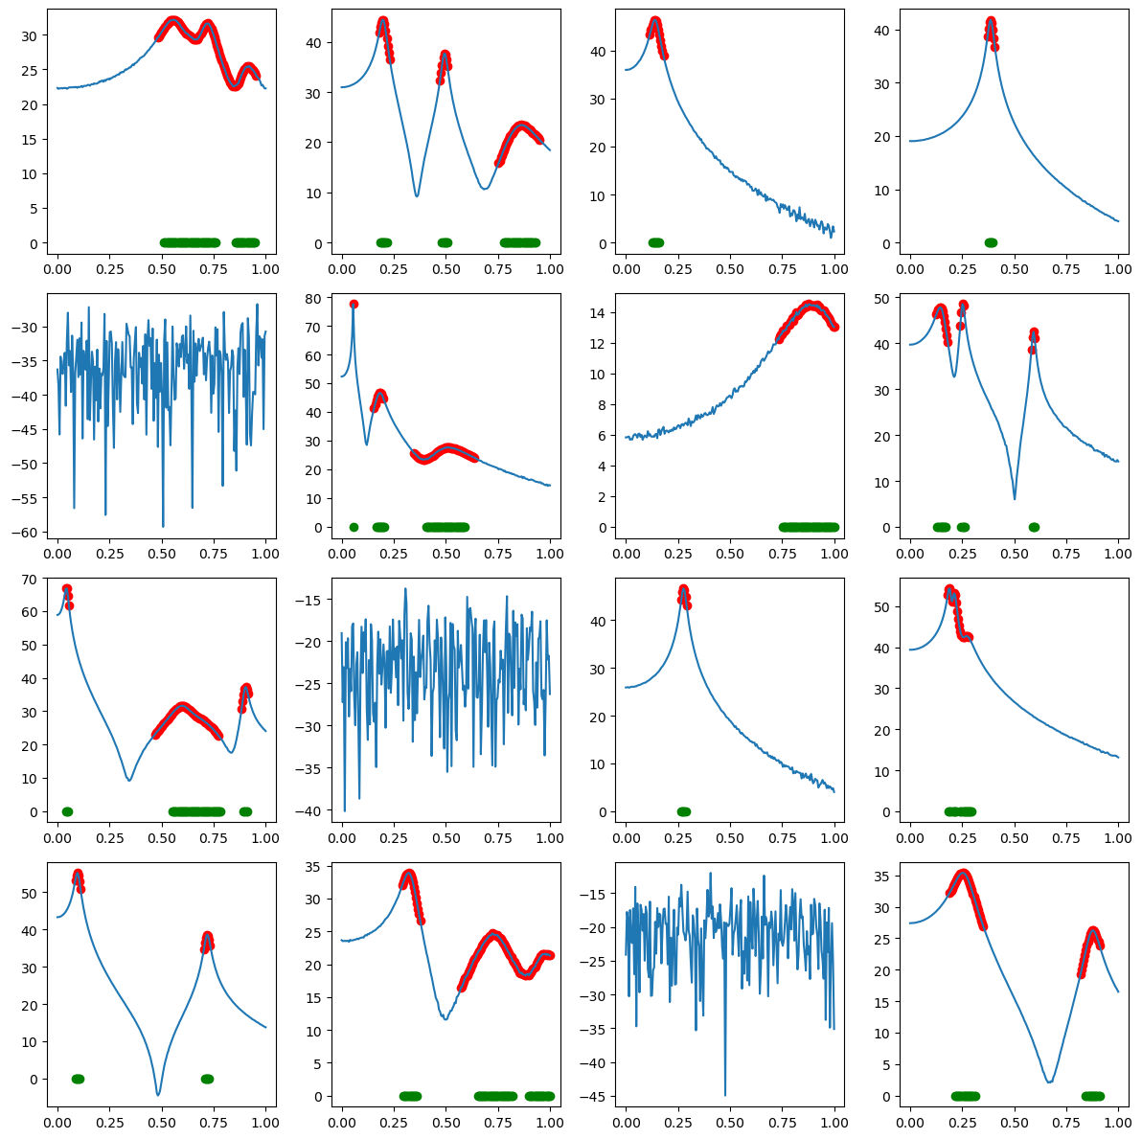
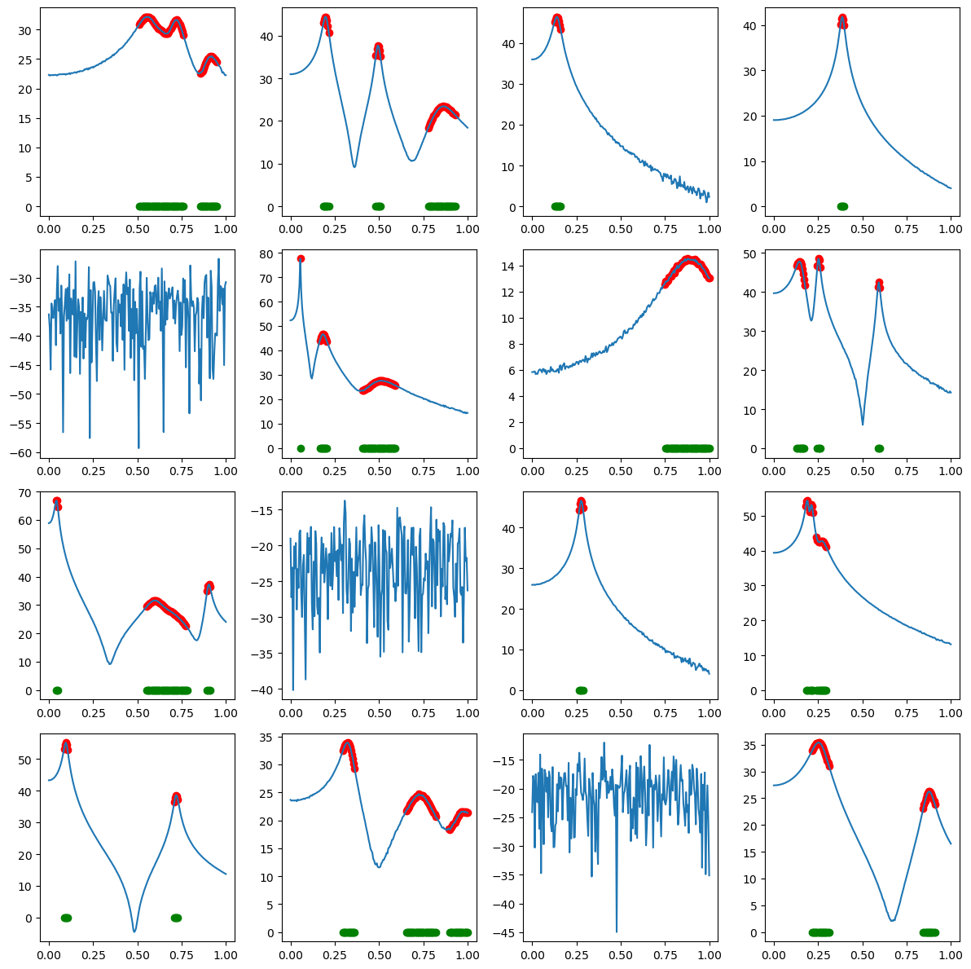
RNN
LSTM

Slide 4
Increased Noise
Max noise standard deviation increased from 0.15 to 1.0 (need to do this systematically with SNR instead – how?)
Also increased max modes from 4 to 5
6h training time – need to try reduce this!
Epoch [100/100], Loss: 0.353, Precision: 0.979, Recall: 0.695, Validation Precision: 0.975, Validation Recall: 0.988
(previous model:
Epoch [100/100], Loss: 0.327, Precision: 0.984, Recall: 0.697, Validation Precision: 0.981, Validation Recall: 0.993)
Only a small drop in performance

Slide 5
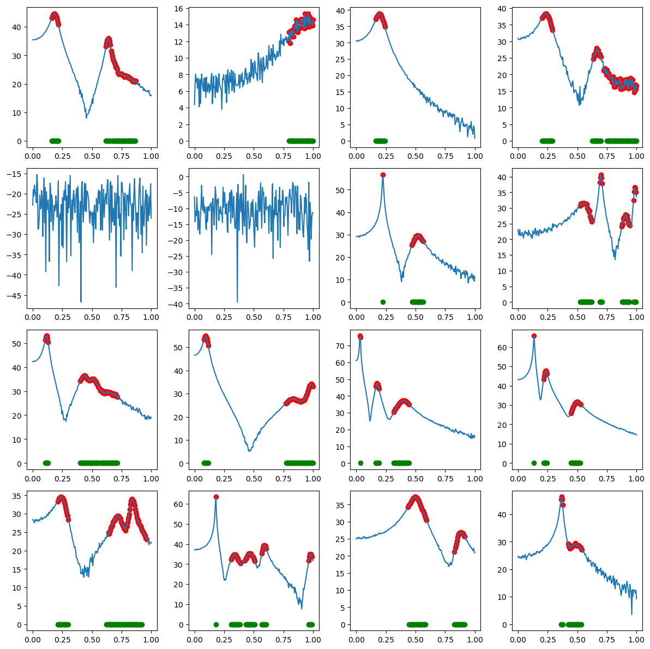

Slide 6
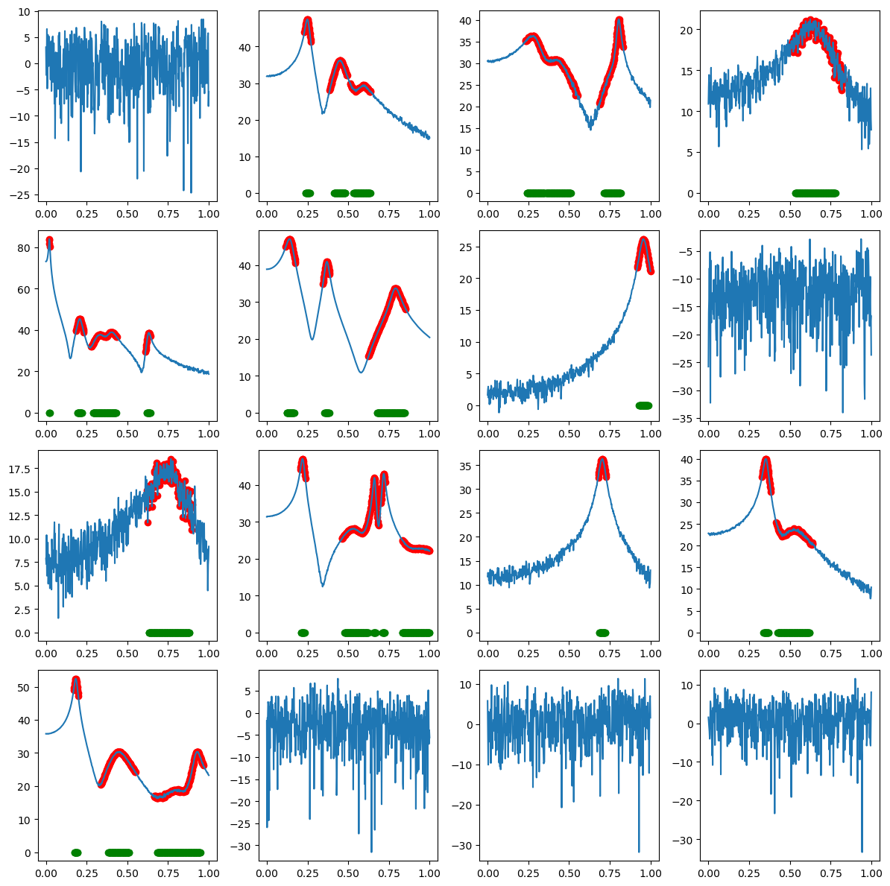
Longer Sequences
Handled inherently by RNN architecture, no need to process data

Slide 7
Real Data
Previous models not working (trained on un-normalised data)
Tried two normalisation methods:
1. Rescale each feature (real and imaginary) to be between -1 and 1
2. Rescale each feature by its squared magnitude
Need to do further testing to see how to best normalise data

Slide 8
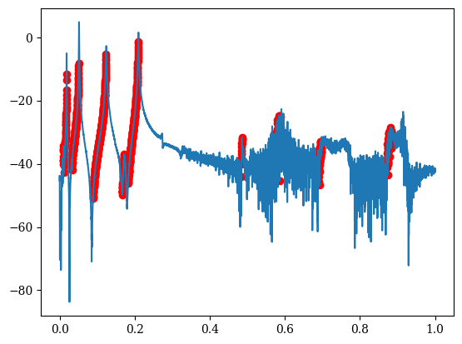
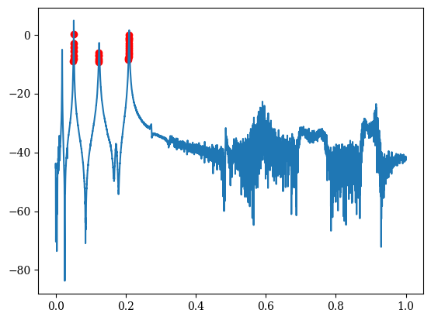
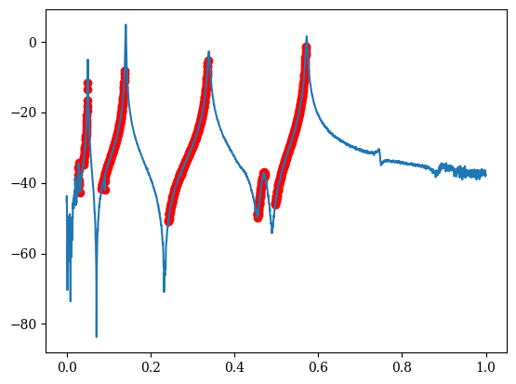
Method 2 (5 epochs)
Method 2 (100 epochs)

Slide 9
Presentation
What level of detail to go in to?

